Slide 1
Research How To
Nik Bear Brown
nik@ccs.neu.edu

Slide 2
Topics
Picking a research topic
Research everywhere!
Analyzing algorithms
Finding a algorithm for you
Playing with algorithms
Analyzing algorithms
How to write a research paper?
Noisy real-world data

Slide 3
Algorithms everywhere!
If it deals with data/information there are algorithms in the background
If it’s on the Internet and changes/updates there are algorithms in the background
Step 1: Choose your topic.

Slide 4
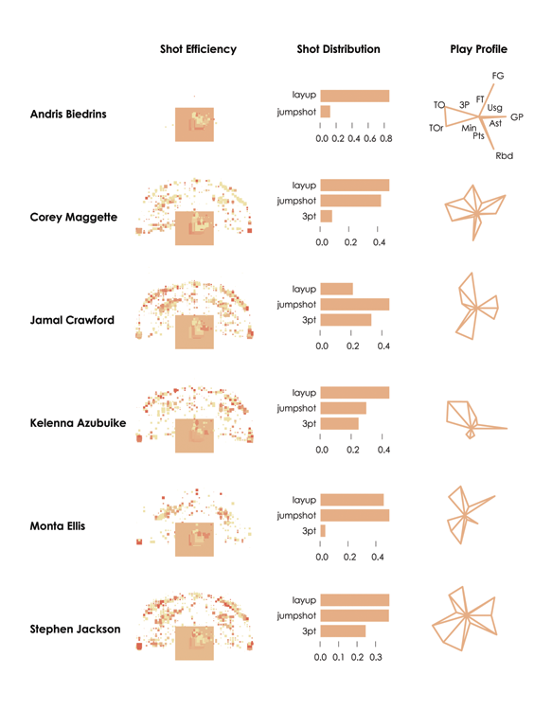
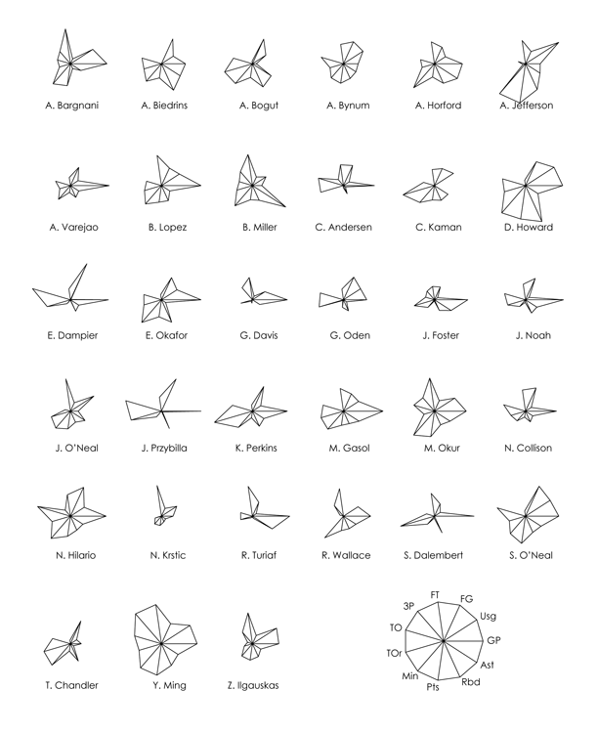
where the player shoots from

Slide 5
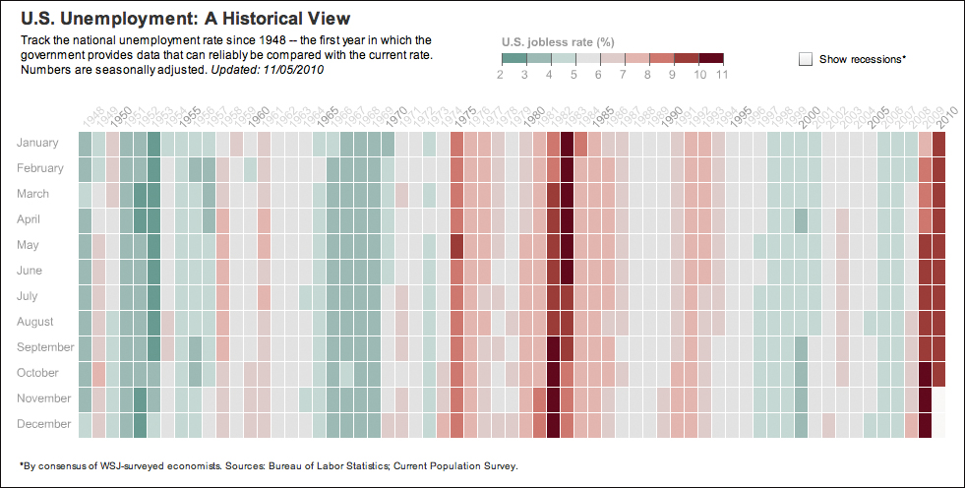

Slide 6
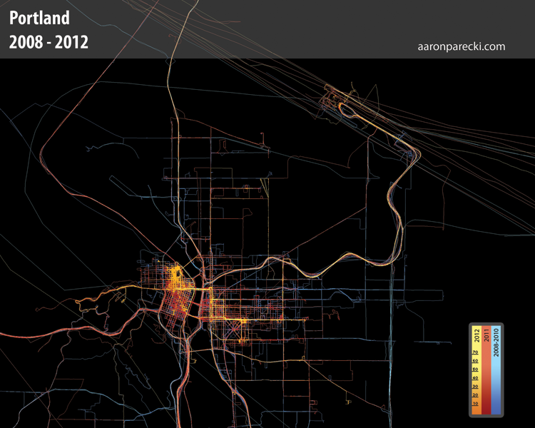
GPS traces collected by Aaron Parecki, http://aaronparecki.com

Slide 7
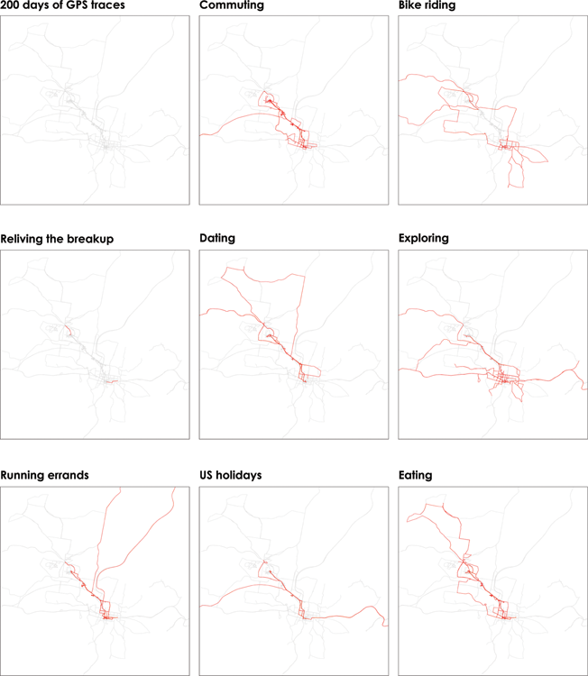
Selected maps from Atlas of the Habitual by Tim Clark, http://www.tlclark.com/atlasofthehabitual/

Slide 8
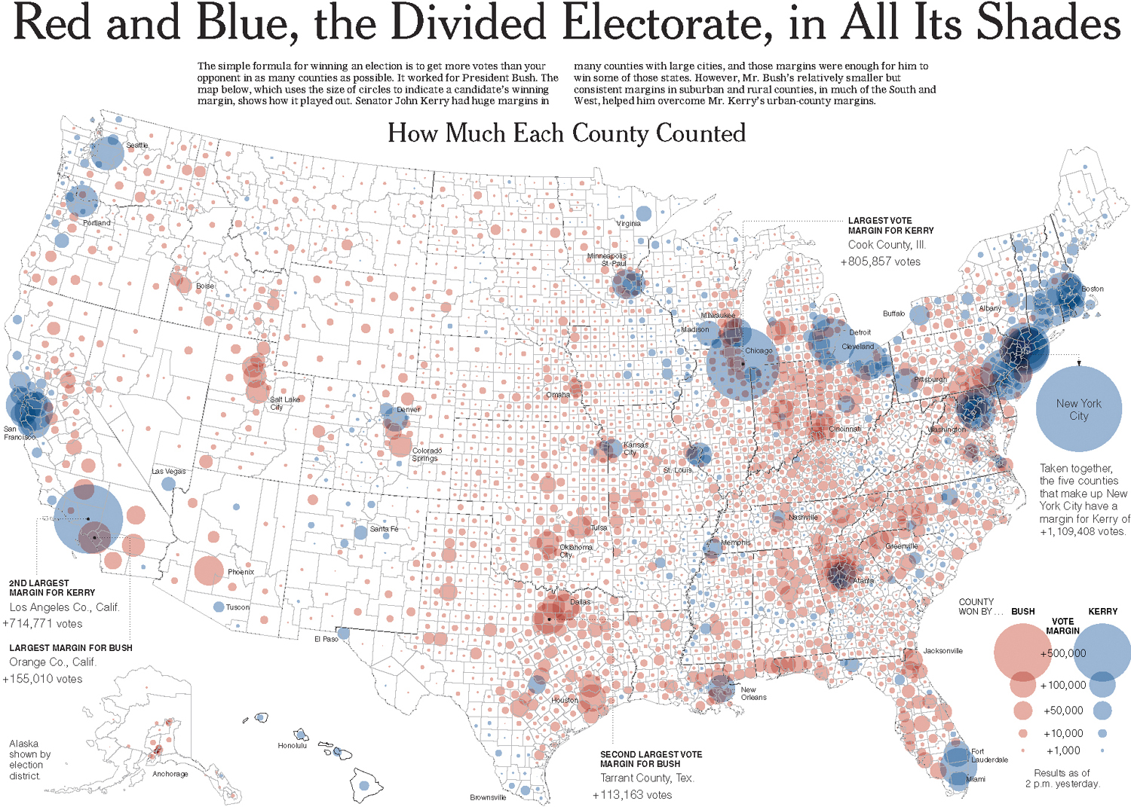

Slide 9
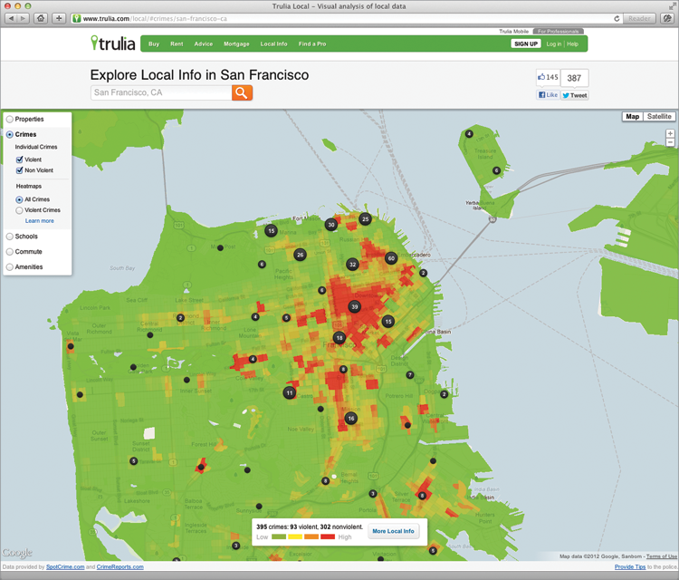
Trulia Local, http://www.trulia.com/local

Slide 10
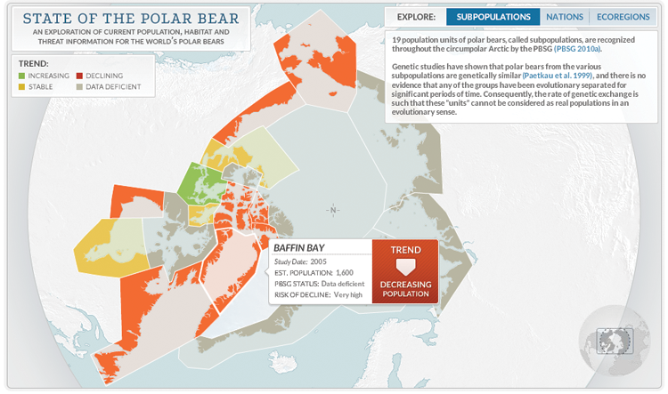
State of the Polar Bear (2012) by Periscopic, http://pbsg.npolar.no/en/dynamic/app/

Slide 11
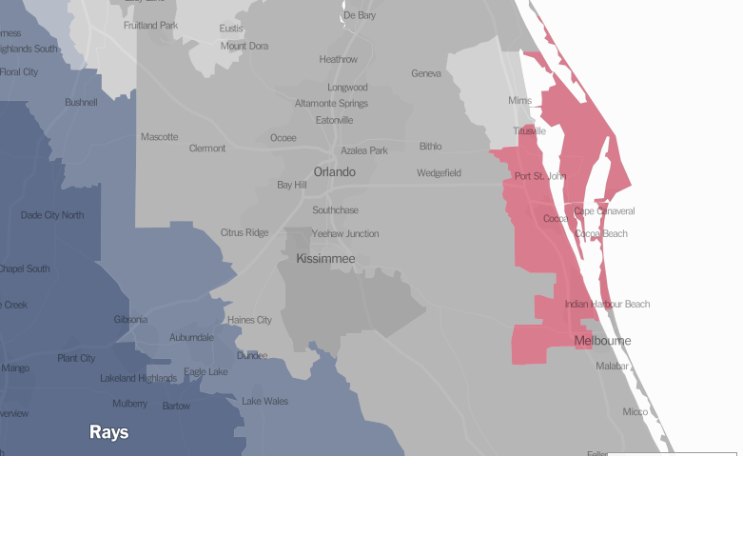
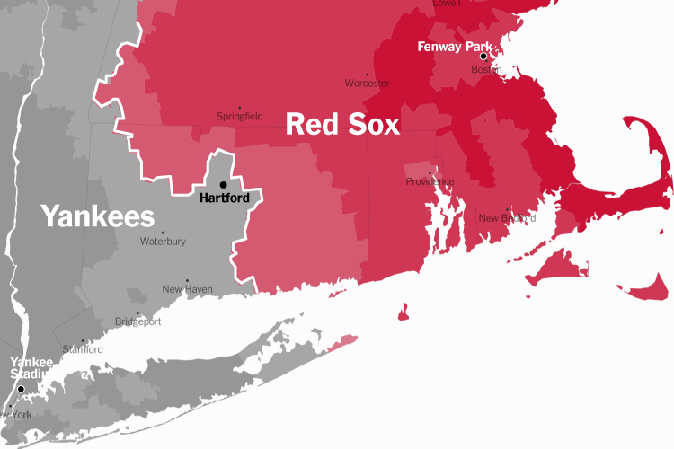
From New York Times

Slide 12


Slide 13
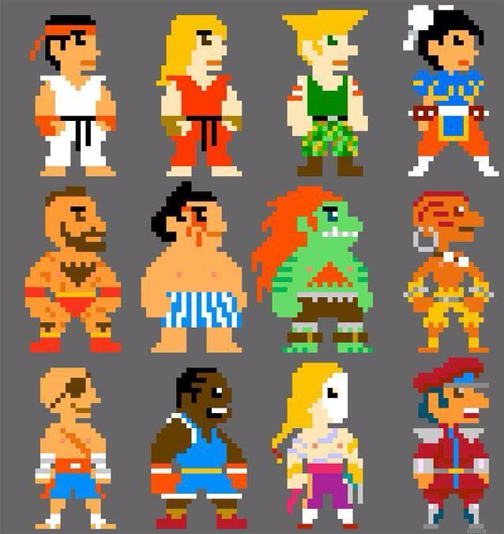

Slide 14
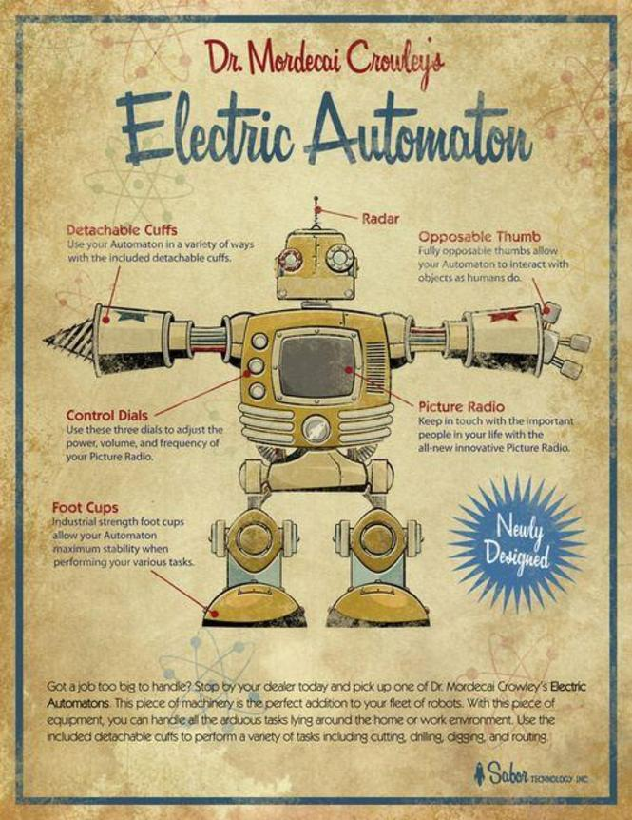

Slide 15


Slide 16
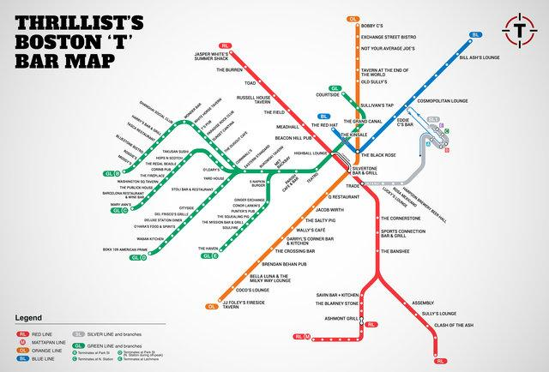
Past Projects

Slide 17
What you will do?
Choose Topic
Find tweak algorithm
Write pseduocode for algorithm
Analyze algorithm (will discuss on Monday)
Find data
Empirically analyze algorithm will real world data (will discuss on Monday)
Write paper

Slide 18
Suggested Organization of a Research Paper
Abstract/Thesis
Introduction:
Motivation
Background
My algorithm
Methods
Results
Discussion
References

Slide 19
Data Sources
Data and Story Library (DASL) (http://lib.stat.cmu.edu/DASL/)—An online library of data files and stories that illustrate the use of basic statistics methods, from Carnegie Mellon Berkeley Data Lab (http://sunsite3.berkeley.edu/wikis/datalab/)—Part of the University of California, Berkeley library system UCLA Statistics Data Sets (www.stat.ucla.edu/data/)—Some of the data that the UCLA Department of Statistics uses in their labs and assignments Freebase (www.freebase.com)—A community effort that mostly provides data on people, places, and things. It’s like Wikipedia for data but more structured. Download data dumps or use it as a backend for your application. Infochimps (http://infochimps.org)—A data marketplace with free and for-sale datasets. You can also access some datasets via their API. Numbrary (http://numbrary.com)—Serves as a catalog for (mostly government) data on the web. AggData (http://aggdata.com)—Another repository of for-sale datasets, mostly focused on comprehensive lists of retail locations. Amazon Public Data Sets (http://aws.amazon.com/publicdatasets)—There’s not a lot of growth here, but it does host some large scientific datasets. Wikipedia (http://wikipedia.org)—A lot of smaller datasets in the form of HTML tables on this community-run encyclopedia. TIGER (www.census.gov/geo/www/tiger/)—From the Census Bureau, probably the most extensive detailed data about roads, railroads, rivers, and ZIP codes you can find OpenStreetMap (www.openstreetmap.org/)—One of the best examples of data and community effort Geocommons (www.geocommons.com/)—Both data and a mapmaker Flickr Shapefiles (www.flickr.com/services/api/)—Geographic boundaries as defined by Flickr users Basketball Reference (www.basketball-reference.com/)—Provides data as specific as play-by-play for NBA games. Baseball DataBank (http://baseball-databank.org/)—Super basic site where you can download full datasets. databaseFootball (www.databasefootball.com/)—Browse data for NFL games by team, player, and season. Global Health Facts (www.globalhealthfacts.org/)—Health-related data about countries in the world. UNdata (http://data.un.org/)—Aggregator of world data from a variety of sources World Health Organization (www.who.int/research/en/)—Again, a variety of health-related datasets such as mortality and life expectancy OECD Statistics (http://stats.oecd.org/)—Major source for economic indicators World Bank (http://data.worldbank.org/)—Data for hundreds of indicators and developer-friendly Data.gov (http://data.gov/)—Catalog for data supplied by government organizations. Still relatively new, but has a lot of sources. Data.gov.uk (http://data.gov.uk/)—The Data.gov equivalent for the United Kingdom. DataSF (http://datasf.org/)—Data specific to San Francisco. NYC DataMine (http://nyc.gov/data/)—Just like the above, but for New York. Follow the Money (www.followthemoney.org/)—Big set of tools and datasets to investigate money in state politics. OpenSecrets (www.opensecrets.org/)—Also provides details on government spending and lobbying.

Slide 20
Keep Track of your Sources.
0
You can use EndNote or other citation software
Use your own words when possible; avoid excessive use of long quotations

Slide 21
Find a Topic
Topic: What information can be predicted about me from carrying around a cel phone?
Find a group a 1-2 other people who are interested in GPS algorithms
Can the group be bigger than 3?

Slide 22
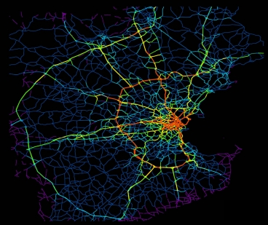
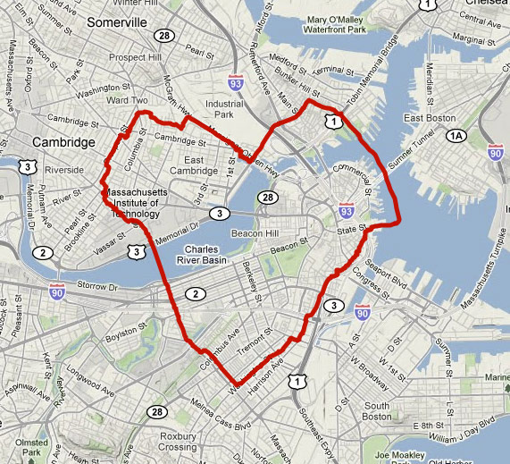
Topic
Topic: Creating a GPS trace algorithm from NMEA logs.

Slide 23
Algorithm Idea
Use NMEA logs to create a directed graph of latitude, longitude and timestamp data. Each node connects to the next node in time.
Should it be bi-directional? How would that effect performance?
How quickly could one find a particular NMEA data point?

Slide 24
Getting NMEA/GPS data
There are many apps that will create GPS logs on your phone.
NMEA Recorder https://play.google.com/store/apps/details?id=com.mephisto.nmearecorder
NMEA gpsRecorder https://itunes.apple.com/us/app/nmea-gpsrecorder/id573152485?mt=8
Wahoo Fitness app http://www.wahoofitness.com/ Log format: Garmin Training Center XML (TCX) or GPX XML
Gaia GPS app http://www.gaiagps.com/ Log format: GPX XML
MotionX-GPS app http://gps.motionx.com/ Log format: GPX XML

Slide 25
Three Main Parts
A Thesis Statement generally consists of three main parts
Your topic, and then the analysis, explanation, or assertion, that you’re making about the topic.
Based on evidence.
Topic/Assertion
Analysis
Points of Support/Evidence

Slide 26
Three Main Parts
Topic
Analysis
Explanation/Evidence
Assertion
Part 1
Part 2

Slide 27
The Don’ts of Thesis Statements
1. Write statements, not Announcements!
Examples of what not to do when starting an essay:
The subject of this paper will be…
I want to talk about …
In this essay I want to express…
My opinion of fast food restaurants is…
This essay is about…
I want to explain the…
2. Avoid statements that are too BROAD!
Example – Men and women are very different.
3. Avoid statements that are too NARROW!
Example – In Canada, a person must be 18 yrs old in order to vote
in the federal elections.
4. Write statements that contain only ONE IDEA!
Example - Group work has many advantages, but at the same time it brings
many difficulties.
Don’t do this! Ever! Bad…very bad!!

Slide 28
Algorithm
Your algorithm must be implemented as code.
Your algorithm must be expressed as pseudocode.
The pseudocode must be analyzed for asymptotic analysis.
The asymptotic analysis must be compared with empirical analysis (on real data).
EVERY step must be analyzed asymptotically and empirically. (In this case everything that needs to be done to convert an NMEA GPS log in to a GPS trace.)

Slide 29
Derivative Projects
Would make sense to work on a related project to the group for the individual project:
Matching GPS trace with roads, trains, etc.
Predicting activity (is phone user running, driving, sleeping, walking, eating, etc.)
Co-traveler algorithms to find associates, friends
GPS position jitter removal
GPS Map Matching problem
GPS based Dating Engine?
Hiding from cel phone tracking?
Many more …..

Slide 30
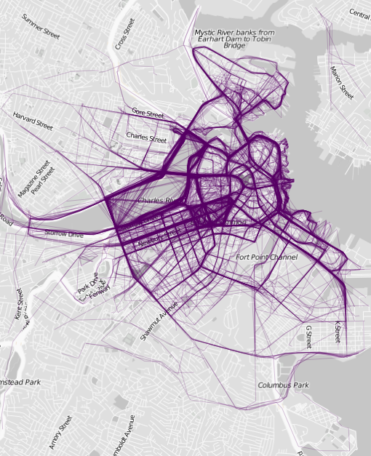

Slide 31
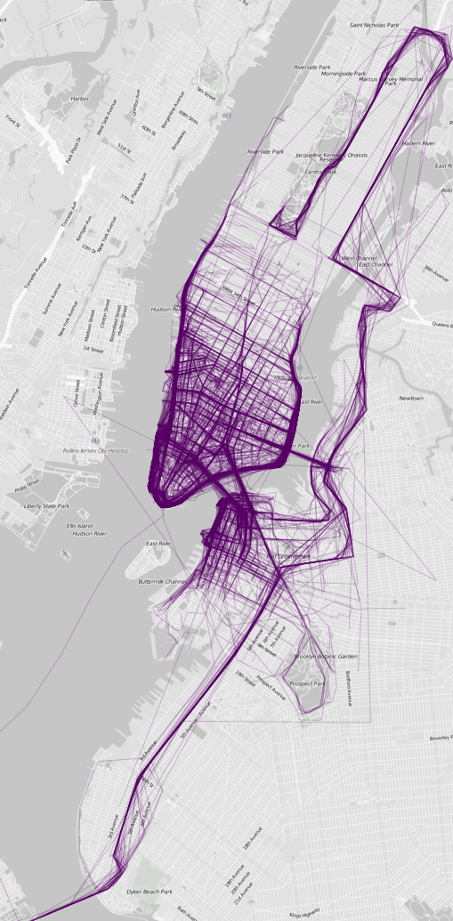

Slide 32
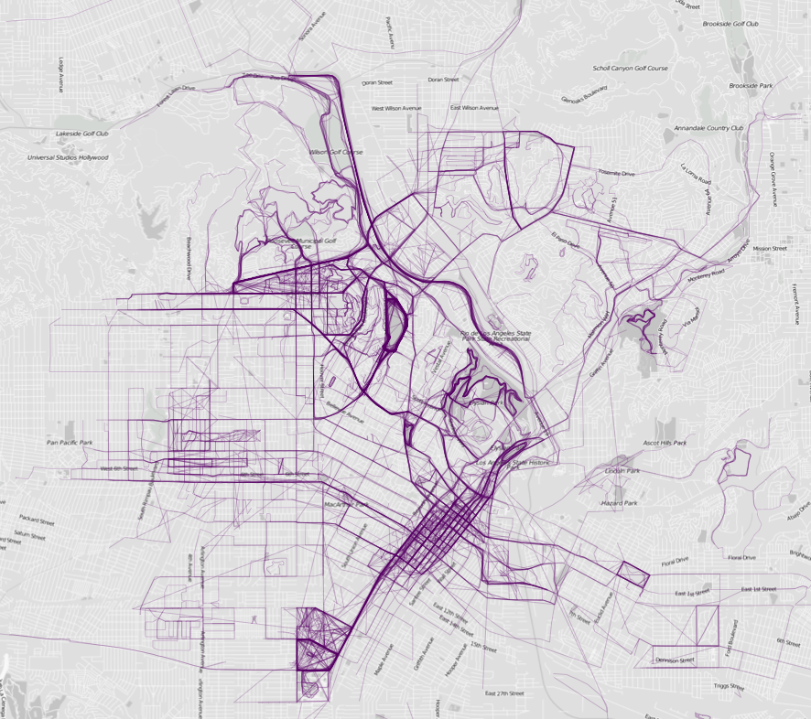

Slide 33
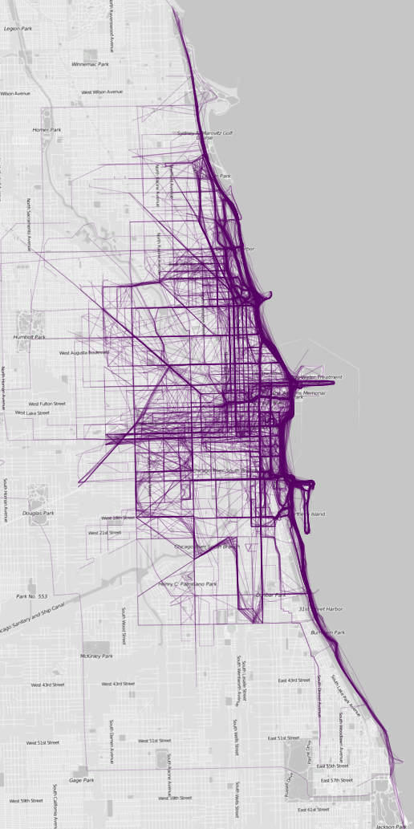

Slide 34
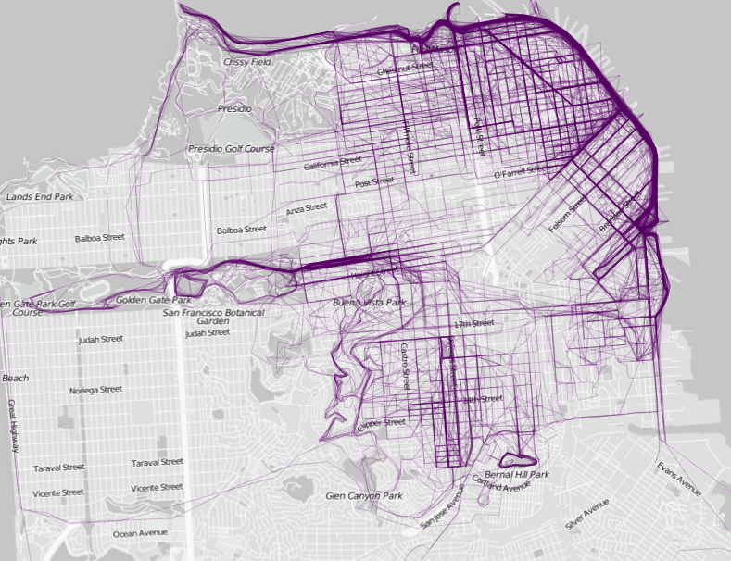

Slide 35
Selected maps from Atlas of the Habitual by Tim Clark, http://www.tlclark.com/atlasofthehabitual/

Slide 36
Code often available
library(plotKML) # GPX files downloaded from Runkeeper
files <- dir(pattern = "\\.gpx") # Consolidate routes in one drata frame
index <- c()
latitude <- c()
longitude <- c()
for (i in 1:length(files))
route <- readGPX(files[i])
location <- route$tracks[[1]][[1]]
index <- c(index, rep(i, dim(location)[1]))
latitude <- c(latitude, location$lat)
longitude <- c(longitude, location$lon)
}
routes <- data.frame(cbind(index, latitude, longitude))
# Map the routes
ids <- unique(index)
plot(routes$longitude, routes$latitude, type="n", axes=FALSE, xlab="", ylab="", main="", asp=1)
for (i in 1:length(ids)) {
currRoute <- subset(routes, index==ids[i])
lines(currRoute$longitude, currRoute$latitude, col="#00000020")
}
http://flowingdata.com/2014/02/05/where-people-run/

Slide 37
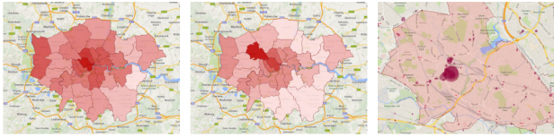
Location Data Is Being Used to Predict the Events You Will Want to Attend
http://www.technologyreview.com/view/526096/how-your-location-data-is-being-used-to-predict-the-events-you-will-want-to-attend/

Slide 38
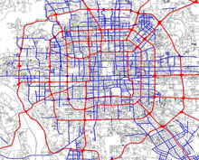
GPS Data on Beijing Cabs Reveals the Cause of Traffic Jams
http://www.technologyreview.com/news/425553/gps-data-on-beijing-cabs-reveals-the-cause-of-traffic-jams/

Slide 39

A Driving Route Made Just for You
http://www.technologyreview.com/news/425271/a-driving-route-made-just-for-you/

Slide 40
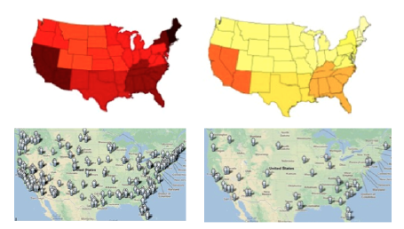
Twitter Datastream Used to Predict Flu Outbreaks
http://www.technologyreview.com/view/520116/twitter-datastream-used-to-predict-flu-outbreaks/

Slide 41

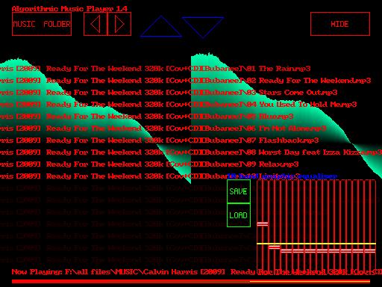
Algorithmic Music
http://www.technologyreview.com/view/426309/the-emerging-art-of-algorithmic-music/

Slide 42
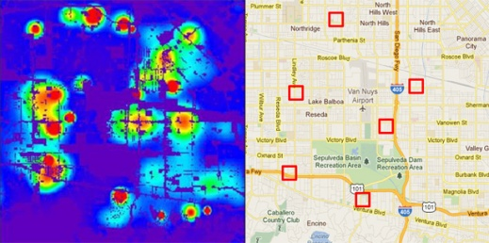
Crime-Predicting Algorithm
http://www.technologyreview.com/news/428354/la-cops-embrace-crime-predicting-algorithm/

Slide 43

Sharing Cascades on Facebook
http://www.technologyreview.com/view/525821/the-curious-nature-of-sharing-cascades-on-facebook/

Slide 44
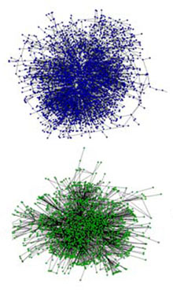
Can Social Networks Be Generated Automatically?
http://www.technologyreview.com/news/418943/can-social-networks-be-generated-automatically/

Slide 45
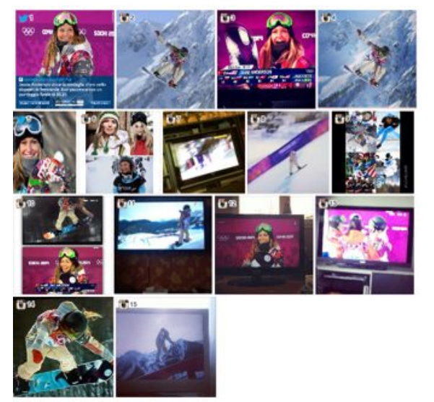
Evolution of Automated Breaking News Stories
http://www.technologyreview.com/view/525911/the-evolution-of-automated-breaking-news-stories/

Slide 46
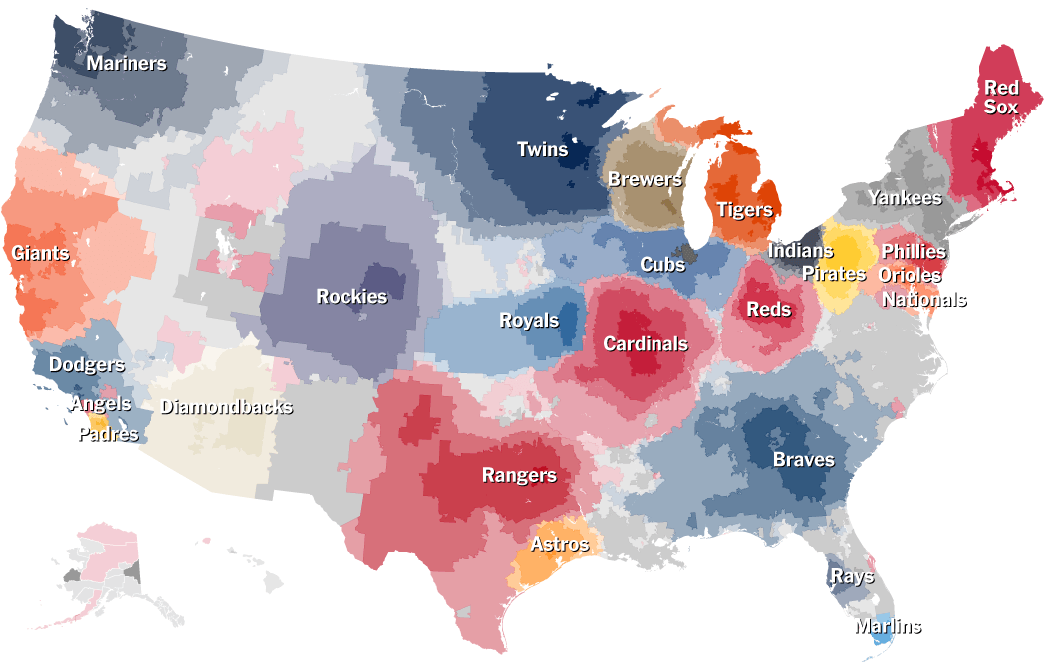
Up Close on Baseball’s Borders
http://nyti.ms/1jlxOTf

Slide 47
From New York Times

Slide 48
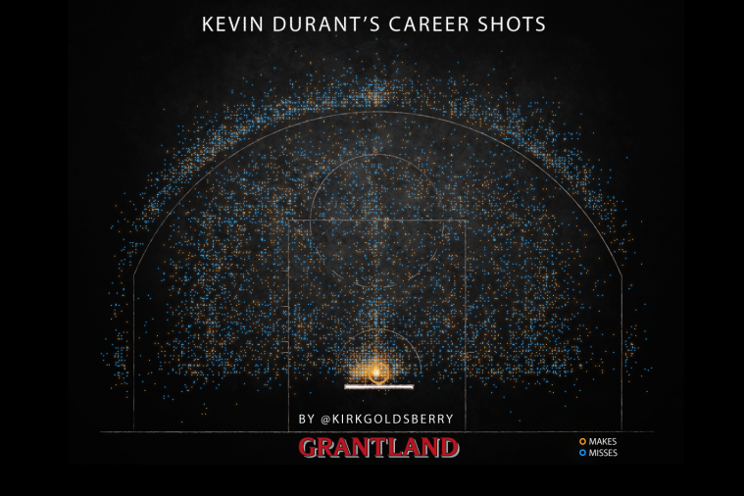
http://grantland.com/the-triangle/true-value-breaking-down-kevin-durants-past-present-and-future/

Slide 49
Project Ideas
Twitter Datastream Used to Predict Flu Outbreaks http://techre.vu/GNaVrU
The Online Dating Engine that Assesses Your Taste In the Opposite Sex (And Whether They Find You... http://techre.vu/1ip18q3
How To Track Vehicles Using Speed Data Alone http://techre.vu/1dcucAD
Scientist Finds PageRank-Type Algorithm from the 1940s http://techre.vu/PSxDlo
Social Media Analysis Reveals The Complexities Of Syrian Conflict http://techre.vu/1aztehu
How Google Ranks Tweets http://techre.vu/XibJZn
The Emerging Art of Algorithmic Music http://techre.vu/Ln6TBS
Algorithm Measures Human Pecking Order http://techre.vu/KH0iRu
Algorithm Uses Photo Networks to Reveal Your Hometown http://techre.vu/VJwpvr
An Algorithm for Preserving Art http://techre.vu/VvBSA9
Algorithm Identifies Top Ten Technology News Trend Setters http://techre.vu/RkAwIw
L.A. Cops Embrace Crime-Predicting Algorithm http://techre.vu/MMIZUb

Slide 50
Project Ideas
Algorithm Predicts Circles of Friends Using Contacts Data http://techre.vu/TXE3LB
The Curious Nature of Sharing Cascades on Facebook http://techre.vu/1lhSInV
The Algorithms That Automatically Date Medieval Manuscripts http://techre.vu/10a5o5C
Will Twitter&#039;s Ad Strategy Work? http://techre.vu/VrHCuO
Can Social Networks Be Generated Automatically? http://techre.vu/OB57zY
The Evolution of Automated Breaking News Stories http://techre.vu/1g3KbwO
“House of Cards” and Our Future of Algorithmic Programming http://techre.vu/Whlf0s
How Fruit Flies Could Improve Wireless Networking http://techre.vu/MCAYg5
A Driving Route Made Just for You http://techre.vu/VUx90R
GPS Data on Beijing Cabs Reveals the Cause of Traffic Jams http://techre.vu/Vqriun
A Useful Twitter Search? http://techre.vu/MrZ6FM
Algorithm Writes People’s Life Histories Using Twitter Stream http://techre.vu/1fcvcoZ

Slide 51
Project Ideas
How Useful Is Personalized Search? http://techre.vu/PUiK24
What's Next for the Netflix Algorithms? http://techre.vu/Y9AUNh
Algorithm Fixes Weather Radar Images Distorted by Wi-Fi http://techre.vu/1oyv9FS
Mesmerizing Maps of Where People Jog Reveal Something Odd: A City's Rich and Poor Neighborhoods by @thetomzone http://mic.cm/1c6D85w
Up Close on Baseball’s Borders http://nyti.ms/1jlxOTf
How Your Location Data Is Being Used to Predict the Events You Will Want to Attend http://techre.vu/1frS3w2 >@TechReview
Visualizing 15 Years Of Acquisitions By Apple, Google, Yahoo, Amazon, And Facebook http://techcrunch.com/2014/02/25/the-age-of-acquisitions/?ncid=twittersocialshare via @techcrunch
This Map Of Planes In The Air Right Now For Thanksgiving Will Blow Your Mind http://www.buzzfeed.com/samir/this-map-of-planes-in-the-air-right-now-will-blow-your-mind via @samir @buzzfeed
How to Burst the &quot;Filter Bubble&quot; that Protects Us from Opposing Views http://techre.vu/IkEb9W >@TechReview
An incredibly detailed map of where Americans are moving: http://gizmo.do/QTWGJdd
This incredibly detailed interactive map shows just how racially polarized the United States is http://bit.ly/1cHa20P
The Science of Familiar Strangers: Society’s Hidden Social Network http://techre.vu/159MFWB >@TechReview

